Slide 1

The Challenge of Causal Inference
Geog 279
Oct 1, 2024

Slide 2
Outline for the Session
0. Some terminology
Why do we do impact assessment?
How do we do impact assessments?
Solutions to the Fundamental Problem of Causal Inference
Approaches to measuring the treatment effect
Implementing an impact assessment

Slide 3
Terminology (a quick recap)
Treatment: is the intervention (‘manipulation’, ‘action’)
Can be a drug, a policy or a shock like being near a wildfire
Can be binary (e.g. exposed to information, given a drug) or continuous (received X$ subsidies; different dosages of drug)
Treatment group: is the group receiving the intervention
The definition is not always obvious (i.e. how do we define ‘near’ a wildfire)
Control group: the group not affected by the intervention
Assuring it’s not affected may be complicated (“SUTVA” violations)
Counterfactual: what would have happened to the treatment group without treatment (and what would have happened to the control group if they had gotten the treatment)
Often estimated using information from the control group

Slide 4
What is a possible treatment?
Holland (JASA, 1986): a treatment is a potential manipulation that we can imagine: “No causation without manipulation”
Argues that to perform an experiment in order to assess the effect of a treatment requires that we can (randomly) manipulate the treatment
We will include ‘quasi-natural’ experiments – trying to identify a setting where even non-manipulatable ‘treatments’ are ‘as random’
e.g. Natural disasters randomly affect some but not others (Fire, flooding, heat,…)
Randomly drawn boundaries may expose similar units to different treatments (landscapes east and west of the German wall were exposed to different environmental policies)
Notes:
“Statistics and causal inference”

Slide 5
Why Do We Do Impact Assessment?

Slide 6

Why Do We Do It?
Want to estimate the impact of a policy or program
$$T⟶M⟶Y_{t}$$
Treatment
(Program Intervention)
Mechanism
Outcome

Slide 7
Theory of Change
Define treatment and anticipated outcomes, mechanisms and moderators
What are we doing, what are we hoping it does and how do we think it will work?
Not trivial; multiple outcomes at multiple scales (water plus biodiversity, economic development)
Defining measures of outcomes can also be complicated
Get potential confounders and insight into program design

Slide 8
Context
Need to understand the context and program rules
Who was eligible?
Who signed up or dropped out (selection bias); e.g. livestock adoption
Particularly important in non-experimental settings
Key to understanding potential confounding factors (e.g. certain sanitation initiatives may be culturally unacceptable)

Slide 9
How Do We Do Impact Assessment?

Slide 10

Compared to What?
We want to compare the outcomes of the program to what would happened otherwise
$$T⟶M⟶Y_{t}$$
$$C{ Y}_{c}$$

Slide 11
Counterfactual
Evaluated in the context of a Counterfactual: what would have happened otherwise?
Can create a counterfactual (medical trials) or can estimate one.
To consider why the program had an effect, one needs to have similar characteristics (and similar heterogeneity) in treatment and control groups.

Slide 12
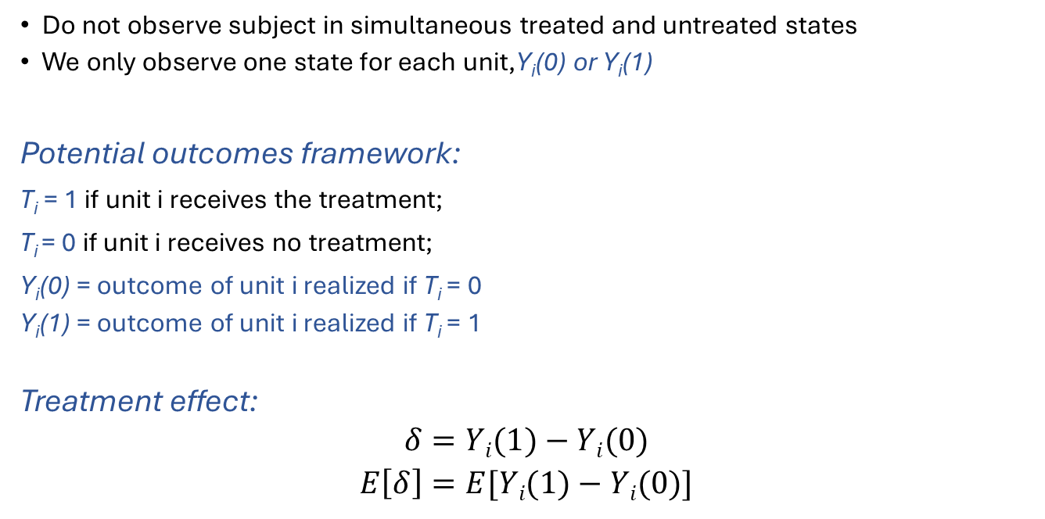
Fundamental Problem of Causal Inference
Do not observe subject in simultaneous treated and untreated states
We only observe one state for each unit,Y_{i}(0) or Y_{i}(1)
Potential outcomes framework:
T_{i} = 1 if unit i receives the treatment;
T_{i} = 0 if unit i receives no treatment;
Y_{i}(0) = outcome of unit i realized if T_{i} = 0
Y_{i}(1) = outcome of unit i realized if T_{i} = 1
Treatment effect:
$$δ=Yi(1)−Yi(0)$$
$$E\left[δ\right]=E[Yi(1)−Yi(0)]$$
Estimates must rely on counterfactuals (hypothetical unobserved value)
The validity of the assumed counterfactual is key to credible causal inference

Slide 13
SUTVA and observed outcomes
SUTVA (Stable-Unit Treatment Value Assumption):
(i) “No interference”: The potential outcomes for unit i do not depend on the treatment of other units (i.e., no interference or spillover across units)
(ii) “Homogenous treatment”: A given unit receiving a specific treatment level cannot receive different forms of that treatment
i.e. the observed outcome Y_{i} only depends on T_{i}
Y_{i} = Y_{i}(T_{i} ) = T_{i} ×Y_{i}(1) + (1 - T_{i} )×Y_{i}(0)
SUTVA is restrictive. It rules out interference, spillovers, general equilibrium effects, peer effects, etc

Slide 14
Most common causal parameters of interest
Average Treatment Effect (ATE)
ATE = E[Y_{i}(1) - Y_{i}(0)]
expected effect of the treatment for a randomly chosen unit
Average treatment effect on the treated (ATT)
ATT = E[Y_{i}(1) - Y_{i}(0) | T_{i} = 1]
expected treatment effect for units who received the treatment
In general ATE and ATT will differ. For example, if the units receiving the treatment are those generally benefiting from it more, we have ATT > ATE
ATE is an average on unconditional distributions of Y_{i}(1) and Y_{i}(0). When is that observed?

Slide 15
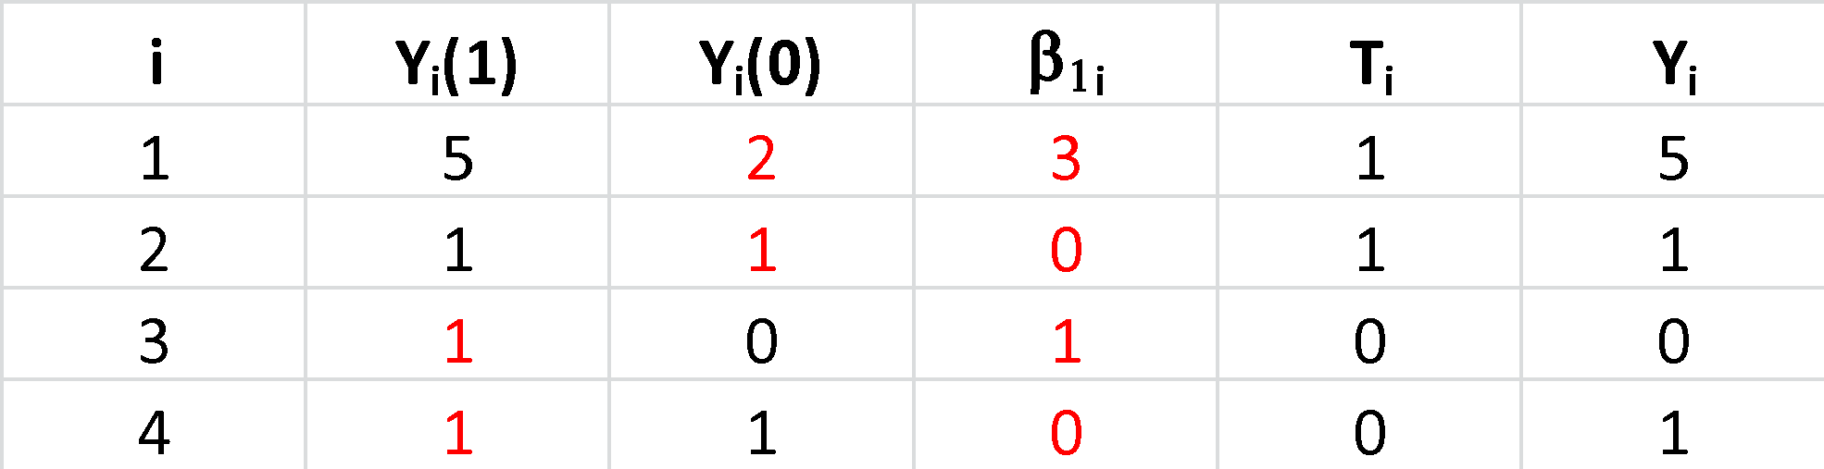
ATE and ATT in context
Example with fictional data set (red font unobserved)
ATE = E[Y_{i}(1) - Y_{i}(0)] = 1 and
ATT = E[Y_{i}(1) - Y_{i}(0) | T_{i} = 1] =1.5
Problem: in general you cannot identify ATE or ATT simply with data on Y_{i} and T_{i}
T_{i}

Slide 16
Requirements for identification
Note that ATE can be written as:
Pr(T_{i}=1)*E[Y_{i}(1) - Y_{i}(0) | T_{i}=1] + {1-Pr(T_{i}=1)}*E[Y_{i}(1) - Y_{i}(0) | T_{i}=0]
for ATE, you need 2 counterfactuals, namely
E[Y_{i}(0) | T_{i}=1] and E[Y_{i}(1) | T_{i}=0]
for ATT, you only need 1 counterfactual:
E[Y_{i}(0) | T_{i}=1]

Slide 17
From potential outcomes to regression
Recall the Rubin Causal Model (for binary treatment)
Y_{i}(0) = potential outcome for unit i if untreated
Y_{i}(1) = potential outcome for unit i if treated
T_{i} = 1 if unit i treated, 0 if not
We observe (Y_{i} , T_{i}), where Y_{i} is the observed outcome:
Y_{i} = Y_{i}(1)×T_{i} + Y_{i}(0)×(1 – T_{i})
= Y_{i}(0) + [Y_{i}(1) – Y_{i}(0)]T_{i}
= E[Y_{i}(0)] + [Y_{i}(1) – Y_{i}(0)]T_{i} + [Y_{i}(0) – E(Y_{i}(0))]

Slide 18
From potential outcomes to regression continued
Y_{i} = E[Y_{i}(0)] + [Y_{i}(1) – Y_{i}(0)]T_{i} + [Y_{i}(0) – E(Y_{i}(0))]
= β₀ + β_{1i}T_{i} + u_{i}
where
β₀ = E[Y_{i}(0)]
β_{1i} = Y_{i}(1) – Y_{i}(0) = unit-specific treatment effect
u_{i} = Y_{i}(0) – E(Y_{i}(0)), so E(u_{i}) = 0

Slide 19
Causal parameters in this regression framework
β_{1i} = Y_{i}(1) – Y_{i} (0) = unit-level treatment effect
E[β_{1i}] = average treatment effect (ATE)
E[β_{1i} | T_{i}=1] = average treatment effect on the treated (ATT)
When there is a single treatment effect (i.e., constant treatment effect) then β_{1i} = β₁, and we obtain a standard bivariate regression model:
Y_{i} = β₀ + β₁T_{i} + u_{i}
where β₁ has causal interpretation = ATE parameter (recall we assume unit-level treatment effect is constant)

Slide 20
Identification of the ATE in this framework
So the model of potential outcomes, with constant treatment effects implies the standard regression model
Y_{i} = β₀ + β₁T_{i} + u_{i}
Can we correctly, i.e. without bias, estimate the causal effect of T_{i} on Y_{i} , β₁ , with data on T_{i} and Y_{i}?
The key is whether the assumption Cov(T_{i},u_{i}) = 0 is satisfied [i.e. u and T uncorrelated]
When is this a reasonable assumption? (Recall that u_{i} = Y_{i}(0) - E[Y_{i}(0)]?)

Slide 21
Three treatment assignment mechanisms
Random assignment of treatment (ensures that treatment is independent of the potential outcomes)
Often the ideal benchmark or ‘gold standard’ of causal identification
Subject of next class taught by Kathy Baylis
Treatment not independent of potential outcomes, selection into T={0,1} based only on observable variables
can "control" for selection if you know the selection rule and have the appropriate data
Treatment not independent of potential outcomes, selection into T={0,1} based on unobservable variables
Need valid instruments, regression discontinuity, panel data, or need to know the statistical distribution of the unobservables

Slide 22
Solutions to the Fundamental Problem of Causal Inference

Slide 23
The Problem
We want to estimate the effect of a policy that targets a specific area
Policy (Treatment)
Issue: what would have happened without the policy?
Choice of location for policy is not random.
It is (somehow) different than other locations not chosen.
The rocks and ice problem
Notes:
e.g. CA for dry areas

Slide 24
Traditional Approach: Before vs After
Ignores overall trend
T
C

Slide 25
Traditional Approach: Inside vs Outside
Ignores how location affects outcome.
T
C

Slide 26
An Example: Water Use (Ferraro, 2009)
Water conservation program to reduce residential water use
Found average water consumption declined 29%
Expanded to new neighbourhood where consumption declined 38%
Great Program!
But….
Rain increased and untreated neighbourhood saw its consumption decline 31%

Slide 27
An Example: Water Use (Ferraro, 2009)
Water conservation program to reduce residential water use
Found average water consumption declined 29%
Expanded to new neighbourhood where consumption declined 38%
Great Program!
But….
Rain increased and untreated neighbourhood saw its consumption decline 31%

Slide 28
Not There Yet…
Much so-called evaluation of program impact is simply monitoring of indicators (did the number of hybrid cars on the road go up? Not necessarily: Did air pollution go down?) and certainly not counterfactual thinking
Realistic theories of behaviour generate ambiguous predictions about impacts.
Many confounding factors correlated with timing and location of interventions (weather in the previous example; milk weed in US; prices in logging)
Selection bias
Thus need counterfactual thinking to sort out true impact.
Notes:
e.g. rebound effect

Slide 29
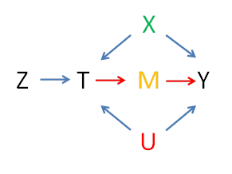
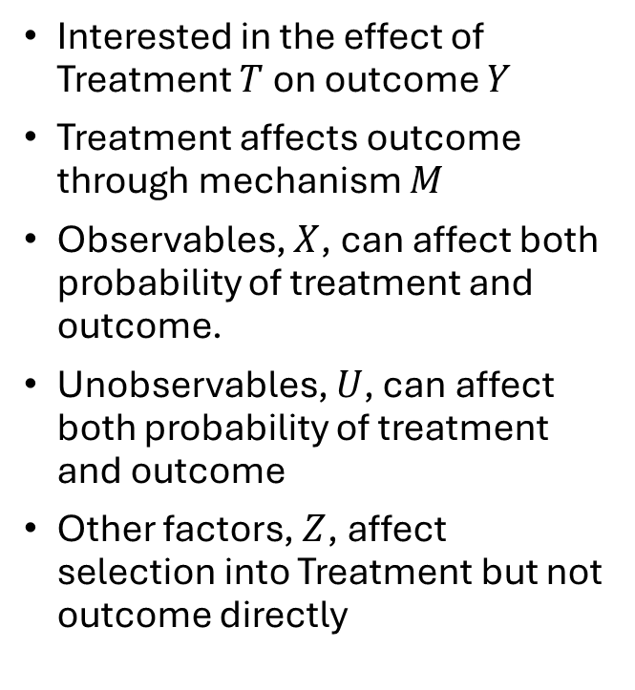
Schematic
Interested in the effect of Treatment $T$ on outcome $Y$
Treatment affects outcome through mechanism $M$
Observables, $X$, can affect both probability of treatment and outcome.
Unobservables, $U$, can affect both probability of treatment and outcome
Other factors, $Z$, affect selection into Treatment but not outcome directly

Slide 30
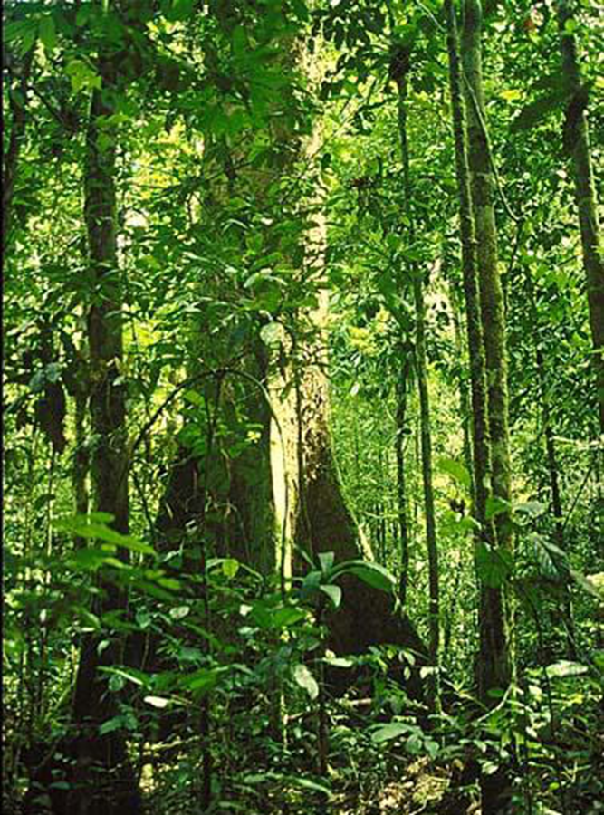

An Example: Agroforestry
Free seedlings $(T)$ create an incentive for households to incorporate trees into agriculture (M), decreasing soil erosion $(Y)$

Slide 31

An Example: Agroforestry
Free seedlings $(T)$ create an incentive for households to incorporate trees into agriculture (M), decreasing soil erosion $(Y)$
Only some randomly-chosen districts get the program $(Z)$

Slide 32
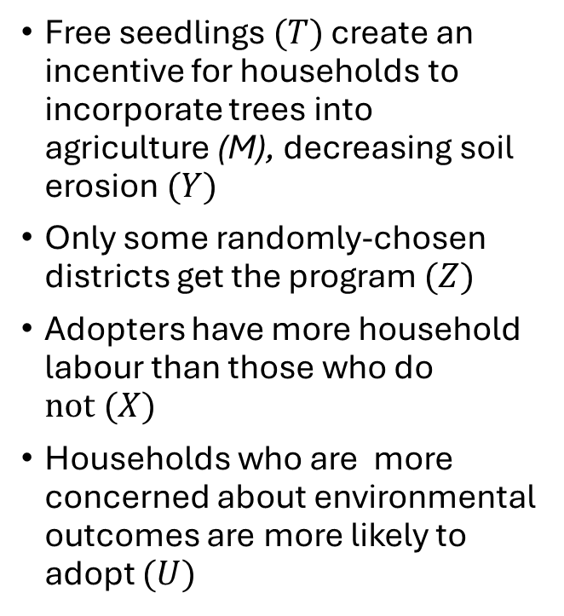
An Example: Agroforestry
Free seedlings $(T)$ create an incentive for households to incorporate trees into agriculture (M), decreasing soil erosion $(Y)$
Only some randomly-chosen districts get the program $(Z)$
Adopters have more household labour than those who do $not (X)$
Households who are more concerned about environmental outcomes are more likely to adopt $(U)$

Slide 33
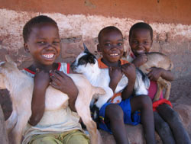
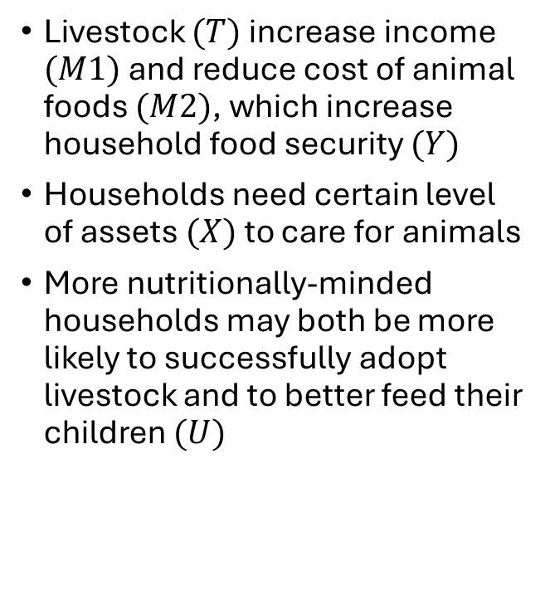
An Example: Livestock
Livestock $(T)$ increase income $(M1)$and reduce cost of animal foods $(M2)$, which increase household food security $(Y)$
Households need certain level of assets $(X)$ to care for animals
More nutritionally-minded households may both be more likely to successfully adopt livestock and to better feed their children $(U)$

Slide 34
Approaches to Measuring the Treatment Effect

Slide 35

Approaches to Estimation
Create variation in $T$ that is unrelated to the outcomes. Eliminate $X$ and $U$ as rival explanations. Focus on treatment effect through mechanisms
RCT
Randomized Roll-out
Randomize access or information

Slide 36

Approaches to Estimation
Condition effect of treatment on $X$
Matching
Difference-in-differences

Slide 37

Approaches to Estimation
Condition effect of treatment on $X$
Matching
Difference-in-differences
(problem is the $U$)

Slide 38
Matching
Find a set of ‘matched’ control (untreated) parcels with similar characteristics to the treated parcels
If we do a good job finding control parcels that look like the treated parcels, we can replicate what would have happened without protection*
*Assumes unobservable characteristics are distributed in the same way as observables: i.e. Matching over observables = matching over unobservables

Slide 39
Difference-in-Difference (DiD)
 | Treatment (Reserve + Payment) | Control (outside Reserve)
Before | T0 | C0
After | T1 | C1
Change | ΔT | ΔC
Difference in Difference |  | ΔT - ΔC
Caveats:
Control and Treatment groups should be similar
Choice of Treated cannot be correlated with unobservables that affect outcome
Control must be ‘uncontaminated’. i.e. not affected by treatment
Works best with random placement. Very rare.

Slide 40
Difference-in-Difference (DiD)
 | Treatment (Reserve + Payment) | Control (outside Reserve)
Before | T0 | C0
After | T1 | C1
Change | ΔT | ΔC
Difference in Difference |  | ΔT - ΔC
Caveats:
Control and Treatment groups should be similar
Choice of Treated cannot be correlated with unobservables that affect outcome
Control must be ‘uncontaminated’. i.e. not affected by treatment
Works best with random placement. Very rare.

Slide 41
Difference-in-Difference (DiD)
 | Treatment (Reserve + Payment) | Control (outside Reserve)
Before | T0 | C0
After | T1 | C1
Change | ΔT | ΔC
Caveats:
Control and Treatment groups should be similar
Choice of Treated cannot be correlated with unobservables that affect outcome
Control must be ‘uncontaminated’. i.e. not affected by treatment
Works best with random placement. Very rare.

Slide 42
Difference-in-Difference (DiD)
 | Treatment (Reserve + Payment) | Control (outside Reserve)
Before | T0 | C0
After | T1 | C1
Change | ΔT | ΔC
Difference in Difference |  | ΔT - ΔC
Caveats:
Control and Treatment groups should be similar
Choice of Treated cannot be correlated with unobservables that affect outcome
Control must be ‘uncontaminated’. i.e. not affected by treatment
Works best with random placement. Very rare.

Slide 43

Approaches to Estimation
Use Z exogenous variation in exposure to the treatment $T$ that does not affect outcome directly
Instrumental variables
Natural quasi-experiments
Regression discontinuity design

Slide 44

Approaches to Estimation
Identification through mechanisms. Estimates effect of treatment on mechanism and then mechanism on outcome
Ferraro and Hanauer: $T$ is protected area status and $Y$ is poverty. $M$’s are (a) ecotourism, (b) ecosystem services (improved), (c) restrictions on land use, (d) infrastructure.
Effect of air pollution on health and then plant emissions on air pollution

Slide 45
Other Examples
RCT:
clean cook stoves
Jack, randomize subsidy to tree-planting contract
Roll-out: livestock
Randomize access to information:
Jensen, call-center jobs
Matching: forest conservation
Difference-in-difference: most RCTs
Natural experiments – air pollution in Mexico
Instrumental Variables – instrument for exposure to the program (Mahila Samahkia; Clean Air Act)
RDD – compare just eligible to just not eligible (Bolivia pension; subway shutdown)

Slide 46

Schematic
C
$$\text{Y}\text{C}$$

Slide 47

Issues ($X$ and $U$)
Selection bias
Confounding factors
Rival explanation
Protected area established in high elevation areas
Air pollution controls established in areas shutting down heavy manufacturing
Can also be an effect in the control
Treatment Heterogeneity
If treatment only works in some (unknown) circumstances, the results are less useful

Slide 48
Treatment Estimates of Indonesian Parks

Slide 49
Treatment Estimates of Indonesian Parks

Slide 50
Implementing an Impact Assessment

Slide 51
So What Can We Do?
Integrate Evaluation into Program Design
Get Baseline Data!
Systematically rule out alternatives

Slide 52
Rule Out Alternative Explanations
2 | 4 | 8
http://www.nytimes.com/interactive/2015/07/03/upshot/a-quick-puzzle-to-test-your-problem-solving.html

Slide 53
Programs Can Cause Their Own Problems
Spillover or leakage
E.g. Forestry
E.g. livestock
Effect of being observed
Hawthorne Effect
John Henry Effect
Pygmalion and Golum effect
E.g. monitoring experiment; CT vs CCT
Anticipatory Effect
Change in behaviour induced by potential program introduction
Notes:
Hawthorne effect 1924-32 experiment at Hawthorne Works – Western Electric factory near Chicago. Changing levels of light – productivity improved with changes
John Henry effect – may work to overcome disadvantage of being in the control
Pygmalion (high expectations) vs golum (low expectations) effect

Slide 54
An Example: Deforestation

Slide 55
Validity
Internal validity (causal relationship)
Construct validity (measuring treatment and outcome one reports)
External validity (would the results be the same in another place/time?)

Slide 56
Critique: Deaton (2009)
Important question is not ‘if it works’ but ‘why (or when and where) it works’
Tests of theory versus test of programs (help with external validity)

Slide 57

Solutions
Randomize $T$
Match based on $X$
IV (use $Z$)
Quasi-experiments, RDD (using Z)
Use Panel Methods to control for U
Rule out alternative explanations

